Slide 1
Water Quality

Slide 2
Water Quality
Amal Alshihabi
Inshirah Almutairi
Hanan Alshehri
By
Dr. Mejdal Alqahtani

Slide 3
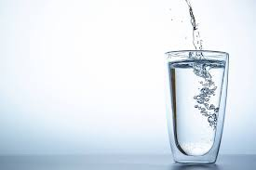
Have you ever asked yourself if the water you drink is really safe or not?

Slide 4

Work Flow Plan
Data Pre-processing
01
02
Data Visualization
Classifier Models
Results
03
04

Slide 5

The goal of the project is: To classify the water usage (Safe or not) based on chemical properties.

Slide 6
Data Description
Data Observations
Columns
Data From
8k
22
Kaggle

Slide 7
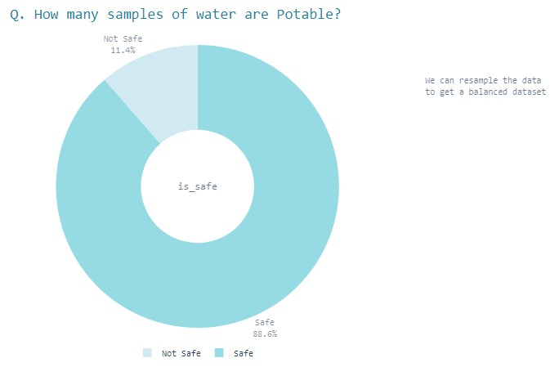


Data Pre-processing

Slide 8
Classification algorithm(Models)
 | Accuracy
Random Forest (RF) | 0.95
k-nearest neighbors(KNN) | 84
Naiive Bayes(NB) | 85
Decision Tree (DT) | 95
Adapttive Boost(AB) | 92

Slide 9
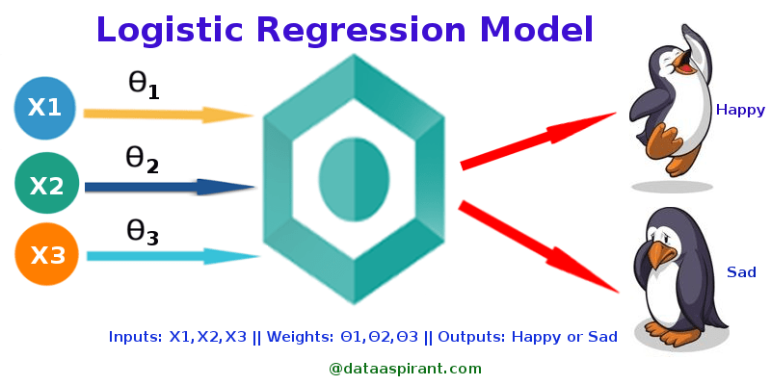
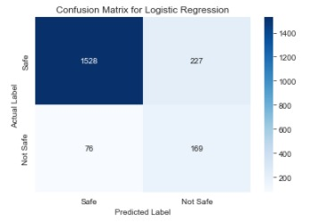
Logistic Regression
Logistic Regression is used when the dependent variable(target) is categorical.

Slide 10
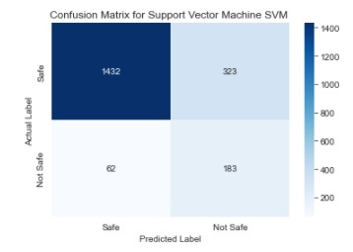
Support Vector Machine(SVM)
Also, (Support Vector Networks) are supervised learning models with associated learning algorithms that analyze data for classification and regression analysis.

Slide 11
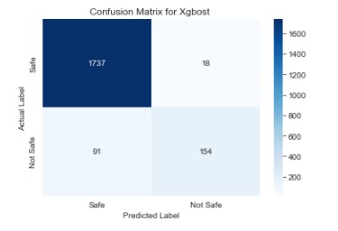

Extreme Gradient Boosting
The XGBoost algorithm is effective for a wide range of regression and classification predictive modeling problems.

Slide 12
CONCLUSION

Slide 13
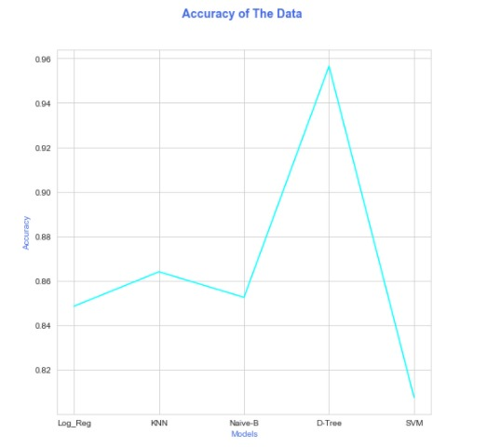
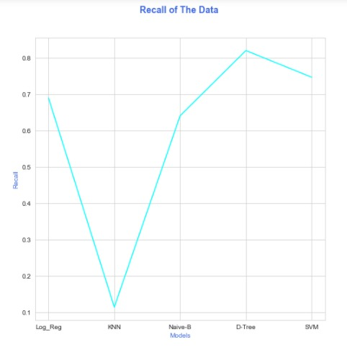

Slide 14
Insights Overview &Future Work
The problem of unbalanced data was solved by changing weights
Future work we would apply it on the Saudi bottled water.

Slide 15
﴿وَجَعَلْنَا مِنَ الْمَاءِ كُلَّ شَيْءٍ حَّيٍ ﴾

